Slide 1
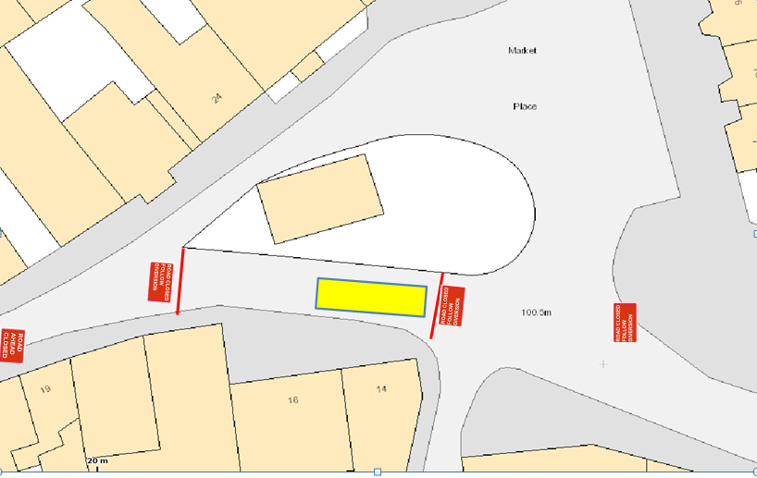
Marlborough St SN7
20/05/2016
Lanes Group Plc 686 Stirling Road Slough SL1 4ST
Diversion
1 day
08/04/2016

Slide 2
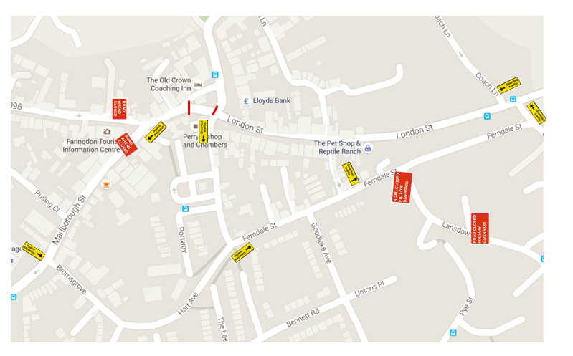
Marlborough St SN7
20/05/2016
Lanes Group Plc 686 Stirling Road Slough SL1 4ST
Diversion
1 day
08/04/2016

